Slide 1
NETWORK AUTOMATION
USING
PYTHON REST-API
INDHU : 412718104007
ANUPRIYA M : 412718104001
B.E (COMPUTER SCIENCE ENGINEERING)
TAGORE ENGINEERING COLLEGE
SUPERVISED BY
MR. SUDDHER REDDY BANDI

Slide 2
ABSTRACT
The Cisco Application Centric Infrastructure (ACI) Provides Powerful new ways to dynamically manage infrastructure in the modern world of IT automation and Develops .
Network automation using python RestAPI. We are building the infrastructure using network automation.
We are going to create a controller that is APIC Controller (Application Policy Infrastructure Controller).
Cisco is providing freesandboxes for people (or) users to practice
And get familiar about and the product, so that users can buy the product

Slide 3
OVERVIEW
Why Automation
What is Cisco APIC Controller
How to access the APIC Controller
What is REST ?
What is API ?
Dashboard of the APIC Controller
Build Network using Python Script

Slide 4
INTRODUCTION
ACME Inc. is a multi-national corporation that specializes in manufacturing, sales, and distribution of a diverse product portfolio, including rocket-powered roller skates, jet-propelled unicycles, and various explosive materials.
These product groups operate as separate business groups within the company, and have previously maintained separate infrastructure and applications.
They have largely focused on retail routes to market, but have recently decided to pursue a more direct-to-consumer business model due to intense pressure from new competitors who have dominated the online sales channels.

Slide 5
PROPOSED SYSTEM
In order to solve the problems in the existing system, the proposed system uses the latest algorithms such as search engine optimization technique, page ranking, indexing and web crawling. This will provide the best search results to the users. The unique and distinct search result is displayed by the proposed search engine to the user’s query.

Slide 7

Why Automation ?
“Configuring Network components manually takes time and can introduce human errors.
With Automation, we can define groups, interfaces, and policies, and then push the configuration from everywhere to APIC controller or any network devices.
Once the scripts are developed and the button is pushed, no human intervention is needed.
David Martinez IT communications manager, Grifols

Slide 8
CISCO
Cisco developer documentation provides in-depth reference information for Cisco product APIs. These APIs are used for networking, automation, mobility and location services, IoT, cloud, security, and collaboration products. Browse the developer documentation for API reference, how-to information, and sample code.

Slide 9
NETWORK CONTROLLER API
Aironet Developer Platform (ADP) - Protoype edge network applications using a hardware development kit (HDK) for the Aironet 3800 series Access Points.
Business Dashboard - Network and lifecycle management for networks built from Cisco 100 to 500 Series routers, switches, and wireless access points.
Data Center Network Manager (DCNM) - Provision, monitor, route, switch, and administer your data center's Cisco Fabric.
Cisco DNA Center - Automate and operate your network to configure and observe at scale, using the Cisco DNA Center REST API.
SD-Access - A fabric-based networking architecture that provides turnkey policy-based operations and assurance for the enterprise network. Design, provision, and manage your wired and wireless networks for edge to the cloud in secured manner with less operational expenses.

Slide 10
Mobility and Location APIs
Connected Mobile Experiences (CMX) Mobility Services - Leverage device location with Wi-Fi and MAC address to improve customer experiences by offering coupons, promotions, and other push notifications to their devices.
Fast Lane Validation - Leverage Fast Lane Validation to optimize the WiFi connectivity and prioritize your business-critical iOS app's traffic on the Cisco Wi-Fi network.
Meraki - Leverage the Location Service APIs to discover real-time location statistics to improve customer engagement and loyalty across sites.
Unified Communications Manager (UCM) Extension Mobility - Enable end-users to access their personal Cisco Unified IP Phone configuration.

Slide 11
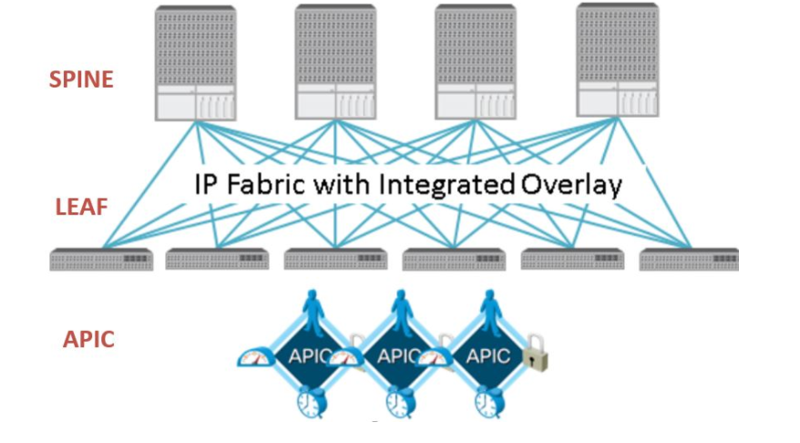
What is Cisco APIC
The Cisco Application Policy Infrastructure Controller (Cisco APIC) is the main architectural component of the Cisco ACI solution.
Cisco’s release of ACI is the SDN solution to automate networking moves, additions and changes in the data center.
An ACI implementation consists of the following three types of hardware components that work together to create the entire ACI fabric:
1.Spines: A group of Cisco Nexus 9000 switches work together to connect to all the leafs.
2. Leafs: As many as 300 Nexus 9000 switches are cabled to the spines as uplinks. The leafs also provide all connectivity downlink to firewalls, load balancers and other routers and switches for external connectivity.
3. APIC: The Cisco Application Policy Infrastructure Controller (APIC) is the central brain for any ACI solution. The APICs provides the single point of management, network performance monitoring and automate network provisioning.

Slide 12
How to access the APIC controller
Cisco is providing free sandbox (testbed) for user to get comfortable in their new products so that companies can invest to build the private cloud infrastructure.
Network engineers can practice Network Automation using (REST API) on Cisco APIC Controller.
https://sandboxapicdc.cisco.com/
Login Credentials : admin/ ciscopsdt

Slide 13
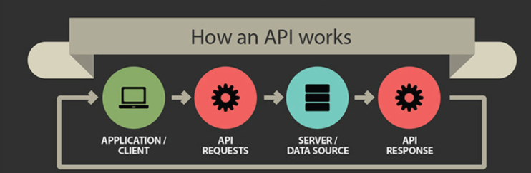
What is REST ?
REST stands for Representational State Transfer
REST is a set of architectural constraints, not a protocol or a standard.
API developers can implement REST in a variety of ways.
When a client request is made via a RESTful API, it transfers a representation of the state of the resource to the requester or endpoint.
Method (GET,POST, etc.)
Media type (xml, json, html).
API stands for application programming interface. This is a concept in software technology that essentially refers to how multiple applications can interact with and obtain data from one another. APIs operate on an agreement of inputs and outputs.

Slide 14
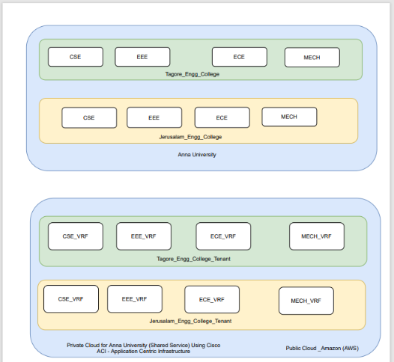
BLOCK DIAGRAM (OR) ACI DIAGRAM

Slide 15
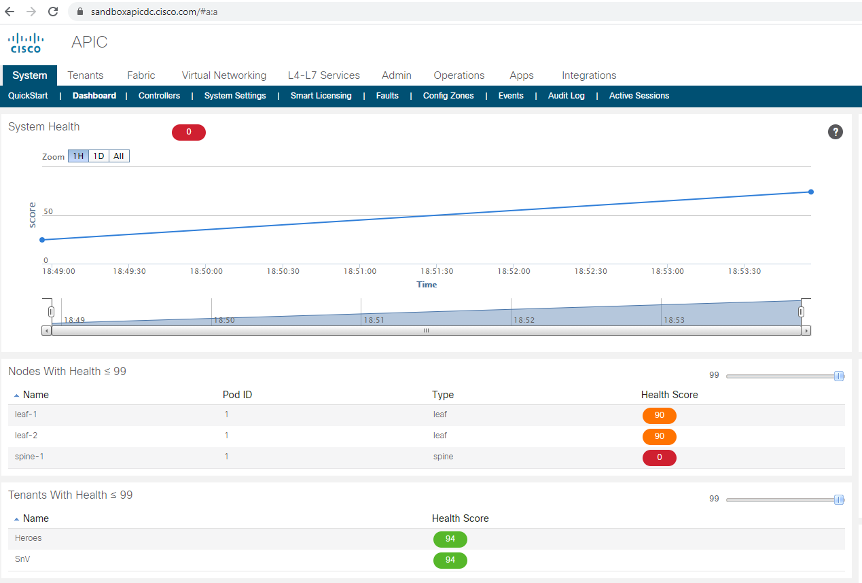
Dashboard of the APIC Controller

Slide 16
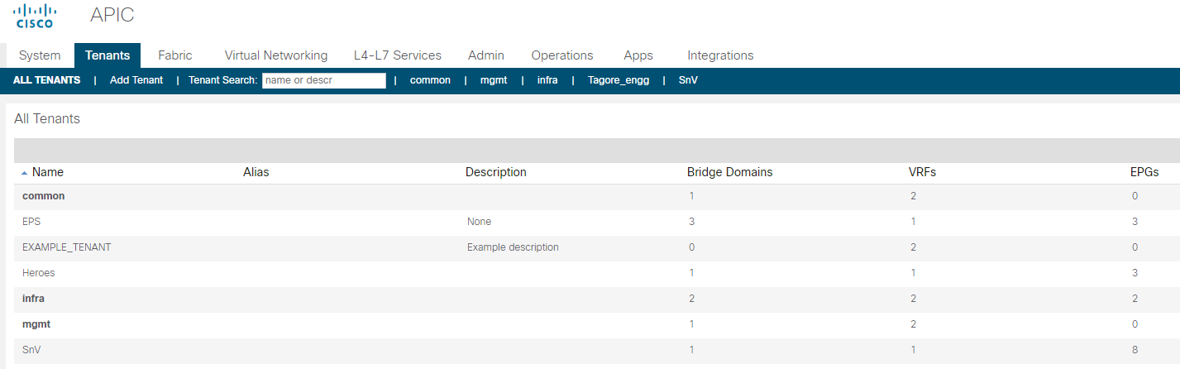
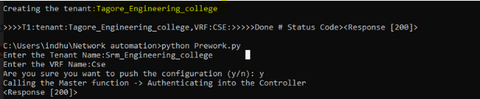
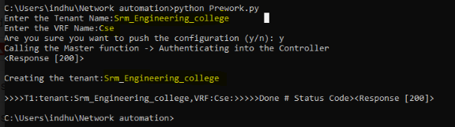
Build Network using Python Script

Slide 17
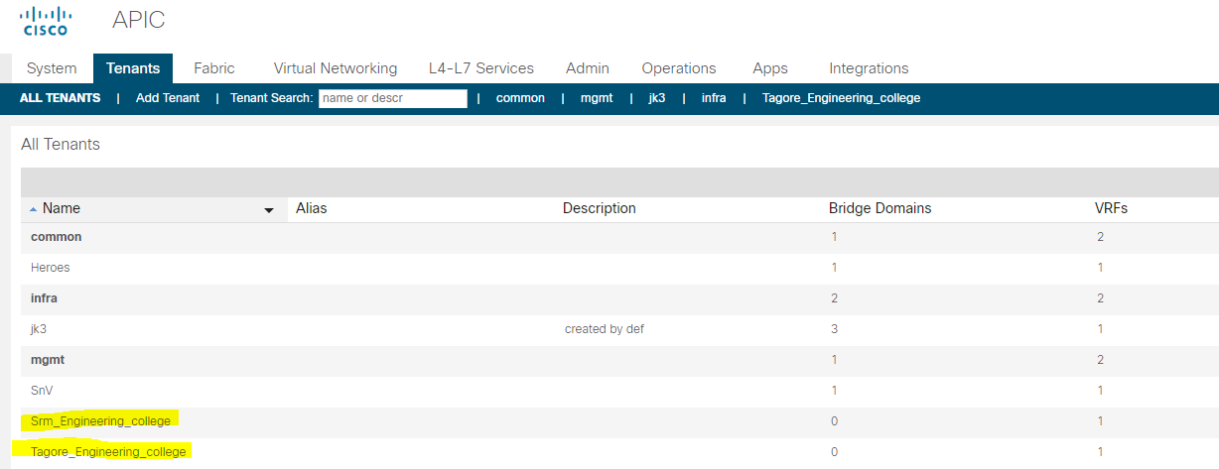
ALL TENANTS

Slide 18
REFERENCE
Aitkin, M. and Foxall, R. (2003). Statistical modelling of artificial neural networks using multi-layer perceptron. Statistics and Computing 13, 227–239.MathSciNetCrossRefGoogle Scholar
Alon, I., Qi, M. and Sadowski, R.J. (2001). Forecasting aggregate retail sales: a comparison of artificial neural networks and traditional methods. Journal of Retailer and Consumer Services 8, 147–156.CrossRefGoogle Scholar.
Anders, U. and Korn, 0. (1999). Model selection in neural networks. Neural Networks 12, 309–323.CrossRefGoogle Scholar.
Barat, C., Loaiza, H., Colle, E. and Lelandais, S. (2000). Neural and statistical classifiers. Can such approaches be complementary? In: Instrumentation and Measurement Technology Conference, Vol. 3, pp. 1480–1486.Google Scholar

Slide 19
REFERENCE
5. Bastos Cavalcante, R. and Ludemir, T.B. (2001). Design of neural networks for time series prediction using case-initialized genetic algorithms. In: Proceedings 8th International Conference on Neural Information Processing, pp. 382–387.Google Scholar
6. Benediktsson, J.A. and Swain, P.H. (1990). Neural network approaches versus statistical methods in classification of multisource remote sensing data. IEEE Trans. on Geoscience and Remote Sensing 28 (4), 540–552.CrossRefGoogle Scholar
.
7.Bernier, J.L., Gonzalez, J., Canas, A. and Diaz, A.F. (2002). Evaluating the impact of multiplicative input perturbations on radial basis function networks. In: European Symposium on Artificial Neural Networks, pp. 237–244.Google Scholar
8.Bissessur, Y., Martin, E.B., Morris, A.J. and Kitson, P. (2000). Fault detection in hot steel rolling using neural networks and multivariate statistics. IEE Proc. Control Theory and Applications 147 (6), 633–640.CrossRefGoogle Scholar

Slide 20

THANK YOU

